Slide 1
Real-time Sign Language Interpretation System
Presented by: Mentored By:
Thennarasu.M Ms.Panimalar.s.p.
Fazil Mohamed.M
Anish George
Rohit.N

Slide 2
Problem Statement
Learning Sign language requires significant amount of time.
Different countries have their respective form of sign gesture communication which results in non-uniformity.
Our project aims at bridging the gap and ensuring the inclusion of deaf and mute community into the conventional world.

Slide 3
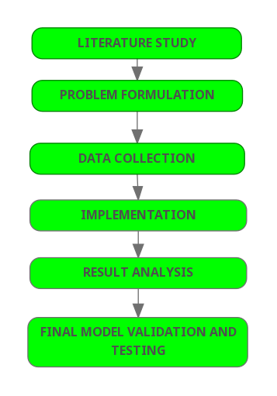
Workflow Diagram
The project has been done according to the given workflow diagram.

Slide 4
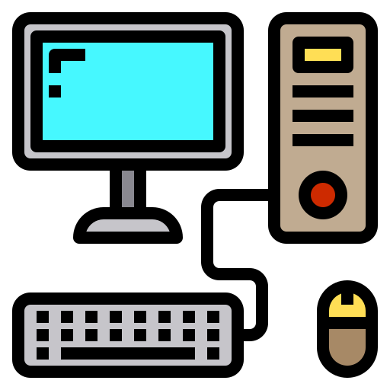

Software/Tools Used
TOOLS USED
TensorFlow Object Detection API
Python
OpenCV
LabelImg
SSD MobileNet
HARDWARE USED
Local machine: 64-bit operating system, x-64 based processor
In-built camera as webcam
SOFTWARE USED
Jupyter Notebook

Slide 5
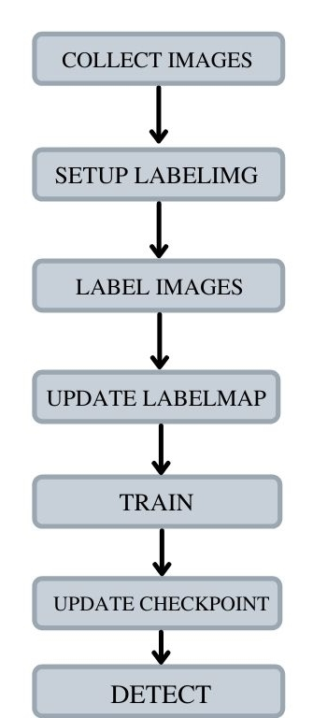
Details of the Project
Coded in Javascript to leverage webcam in colab to collect images for training.
Setup labelIng, which is an open source package that allows to label images for object detection.
Labelled each one of the sign language poses on local machine.
Labelmap is a representation of all the different objects that are in the model.
Trained the model after setting up the configuration.
This loaded the model and regenerated it based on the training.
Detected sign language in real time.

Slide 6
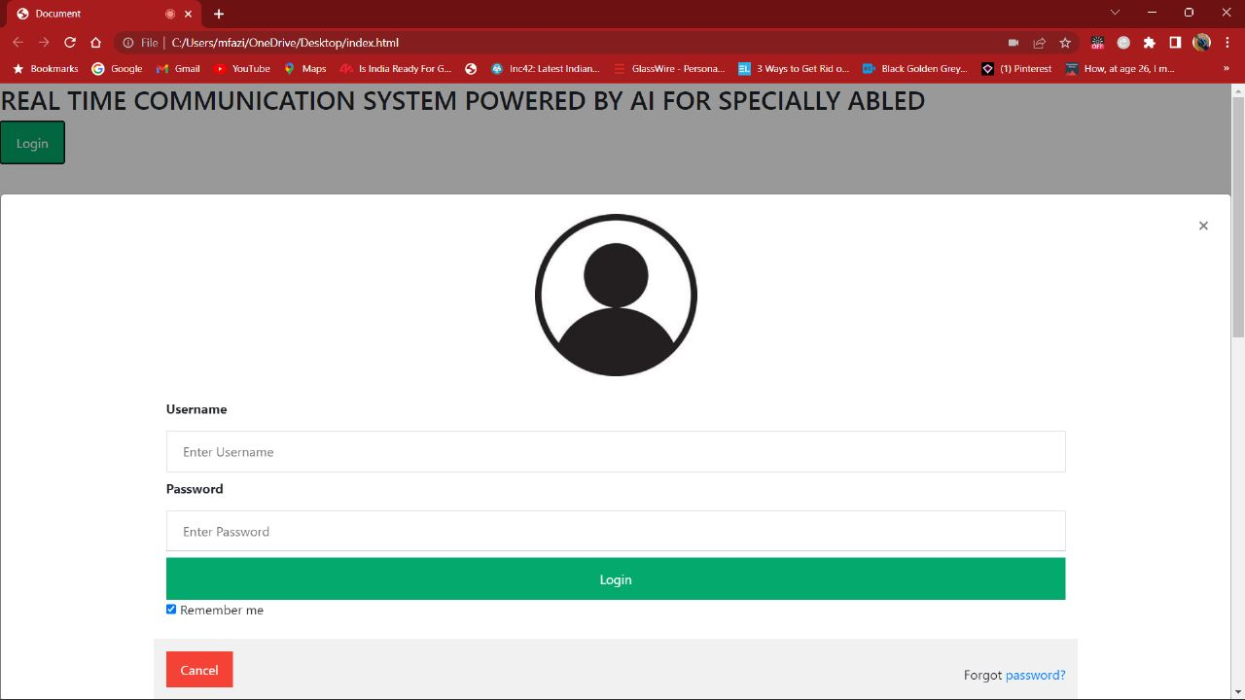
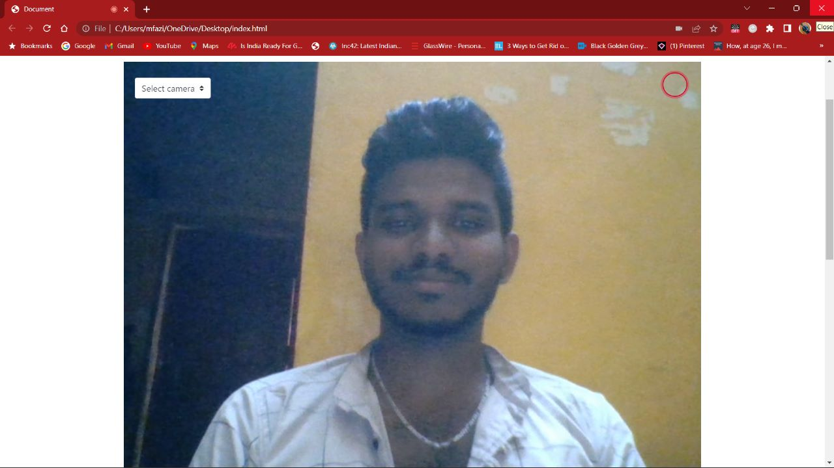
Interface

Slide 7
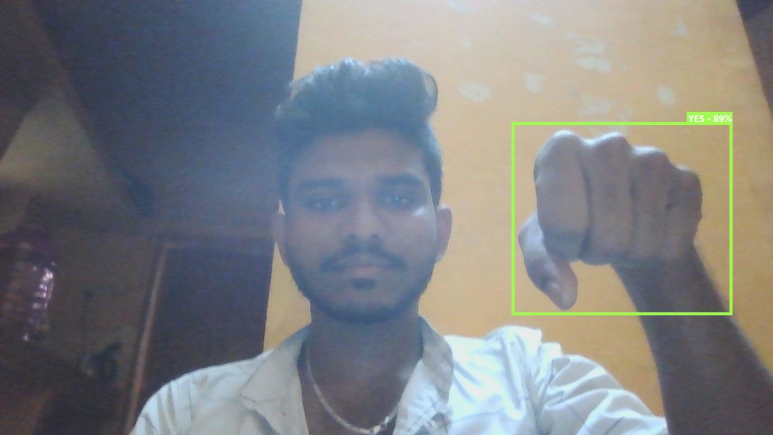
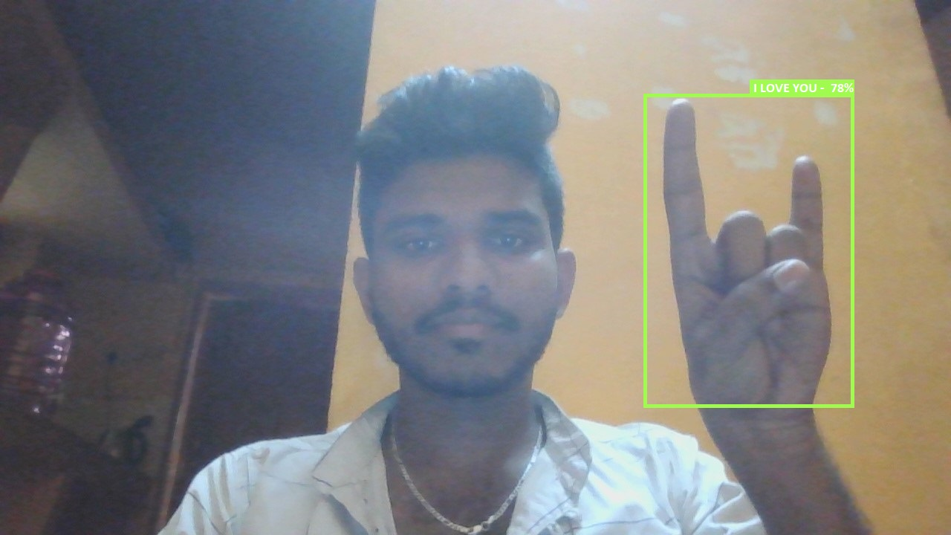
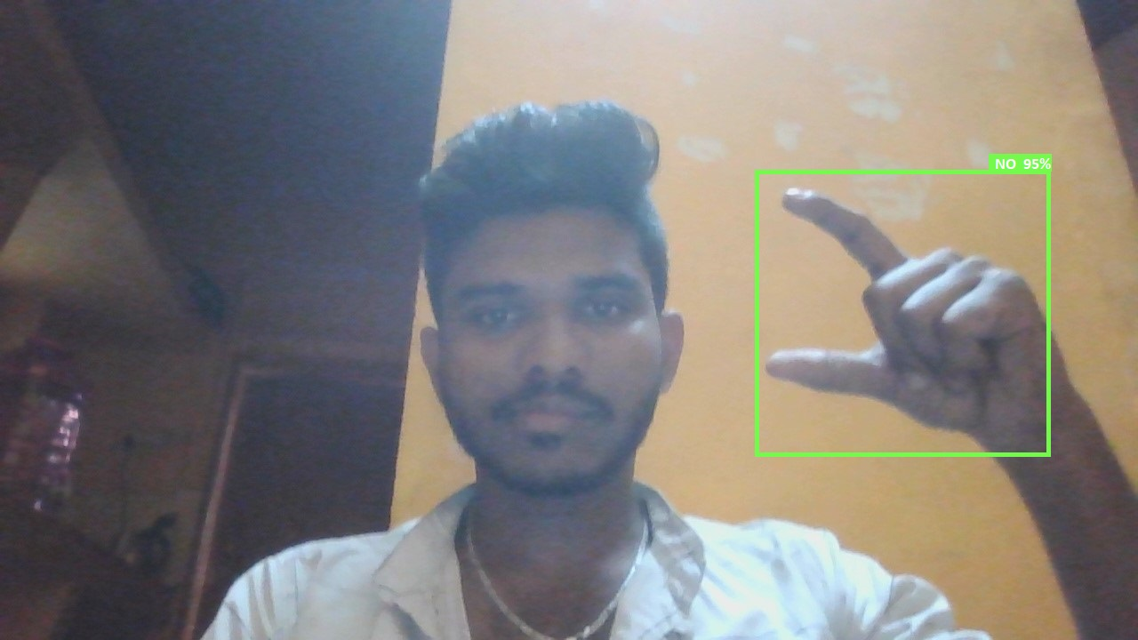
Results
Our model now recognises the following sign languages: - I Love You
- Yes
- No

Slide 8
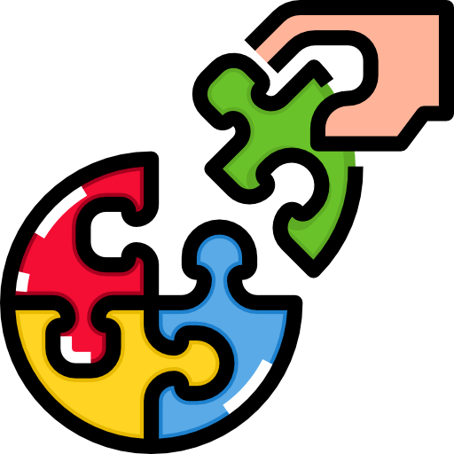
Contribution To Society
Integrate the deaf and mute community into the conventional world..
Smoothen the day-to-day interaction of deaf and mute people.
Recognise the diverse range of sign languages present around the globe.
Provide a feasible platform for the conventional world to interact with the deaf and mute community.
Eliminate discrimination because of the perceptable communication gap.

Slide 9

Future Scope
Upgrade dataset and training to recognise combination of static gestures.
Interpretation of facial expression by the real-time system.
Inclusion of different types of sign languages.
Integrating more words into the vocabulary of the system.

